Slide 1
Mental Health Assessment of a patient I: History taking
DCM 2 lecture, sem1 2023
GCOHES
By;
Brian.S.N, MBChB, GUM

Slide 2
What are the purposes of history ?
For establishment of a diagnosis. (majorly students)
For forensic purposes (e.g. crime, court cases etc.) [basically psychiatrists and the PCOs]
For proper patient follow-up and management [all clinicians attending to psychiatric and non psychiatric patients at different facilities]
Notes:
For follow-up history emphasis is put on past psychiatric history, monitoring the progress of the illness, and quality of life of the patient.

Slide 3
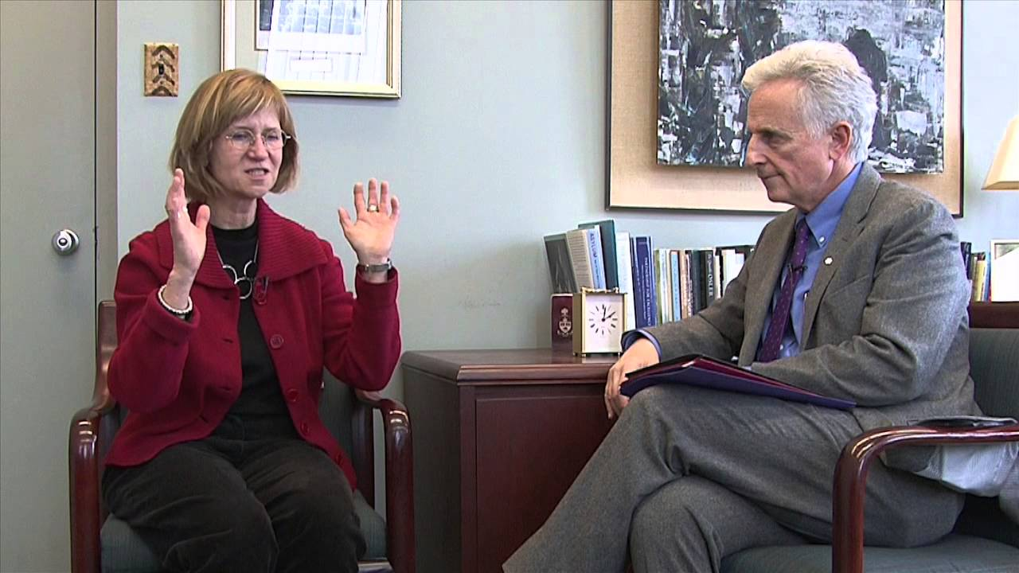
History taking in psychiatry

Slide 4
Outline
History taking in psychiatry
Clinical interview
Must knows before the clinical interview
Setting the scene
Interview structure
Questioning techniques

Slide 5
Clinical interview
In psychiatry, physical examination and investigations are rarely of diagnostic value.
Diagnosis is based on the clinical interview and, to a lesser extent, the later course of the patient's illness.
Clinical interviewing is thus the central skill and development of clinical interviewing skills is the main aim of basic psychiatric training.

Slide 6
Clinical interview
The clinical interview includes both history taking and mental state examination.
The mental state examination is a systematic record of the patient's current psychopathology.
In addition to its role in diagnosis, the clinical interview begins the development of a therapeutic relationship and is, in many cases, the beginning of treatment.

Slide 7
Must know. Before the interview
Safety
There is a risk of aggression or violence in only a small minority of psychiatric patients. In the vast majority of patients the only risk of violence is towards themselves.
However, the fact that violence is rare can lead to health care providers putting themselves at risk due to thoughtlessness.
To combat this it is important to think about the risk of violence before every consultation with a new patient or with a familiar patient with new symptoms.

Slide 8
Must know. Before the interview
Before interviewing a patient, particularly for the first time, consider: -who you are interviewing ?
-where you are interviewing them from ?
-with whom are you ?
Ensure that the nursing staff have this information.
If possible, review the patient's records noting previous symptomatology and episodes of previous violence (the best predictor of future violence).

Slide 9
Before the interview- violence
A number of factors will increase the risk of violence including:
-previous history of violence
- psychotic illness
- intoxication with alcohol or drugs
-frustration
-feeling of threat (which may be delusional or relate to real world concerns).

Slide 10
Setting the scene
The ideal interview room has two doors, one for you and one for the patient. If this is not available sit so that the patient is not between you and the door.
Remove all potential weapons from the interview room.
Familiarize yourself with the ward's panic alarm system and security system before you first need to use it.
If your hospital organises break-away or aggression management training courses, attend these regularly to keep your skills up-to-date.

Slide 11
Setting the scene
Introductions
Observe the normal social forms when meeting someone for the first time.
Introduce yourself and any accompanying staff members by name and status.
Ensure that you know the names and relationships of any people accompanying the patient (and ask the patient if they wish these persons to be present during the interview).
It is best to introduce yourself by title and surname and refer to the patient by title and surname.
Seating
The traditional consultation room, with the patient facing the clinician across a desk is inappropriate in psychiatry.
Use two or more comfortable chairs, of the same height, orientated to each other at an angle. This is less confrontational but allows direct eye contact as necessary. A clipboard will allow you to write notes as you go along.

Slide 12
Setting the scene
Explanation
Inform the patient of your status and level of education/speciality and explain the purpose of the interview.
Explain the reasons for referral as you understand them and inform the patient of the information you have been told by the referrer. Patients often imagine you know more about them ‘’than you actually do.’’
It is helpful to indicate to the patient how long the interview will last; this will allow both of you to plan your time.(45minutes)
Advise them that you may wish to obtain further information after the interview from other sources, and obtain their consent to talk to any informants accompanying them if this would add to your assessment.

Slide 13
Setting the scene
Documentation
For all clinical interviewing a written account is crucial, both as a way of recording and communicating information and as a medico-legal record.
It is best to write up the account as you go along. This saves time afterwards and allows for a more accurate account of the patient's own words.
The record should be legible, signed, and dated, and ordered in a standard fashion.
Initially you may find it helpful to write out the standard headings on sheets of paper beforehand.

Slide 14
Interview structure
The exact internal structure of the interview will be decided by the nature of the presenting complaint. However, the interview will generally go through a number of more or less discrete phases:
Initiation
Introduce yourself and explain the nature and purpose of the interview. Describe how long the interview will last and what you know about the patient already.
Patient led history Invites the patient to tell you about their presenting complaint.
Use general opening questions and prompt for further elaboration. Let the patient do most of the talking: your role is to help them to tell the story in their own words.
During this phase you should note down the major observations in the MSE. Having completed the history of the present complaint and the MSE you will be able to be more focused when taking the other aspects of the history.

Slide 15
Questioning techniques
Open vs. closed questions
An open question does not suggest the possible answers; a closed question expects a limited range of replies (can you tell me how you are feeling? and is your mood up or down at the moment?).
In general, begin the interview with open questions, turning to more closed questions to clarify details or factual points.
Non-directive vs. leading questions
A leading question directs a patient towards a suggested answer (e.g.is your mood usually worse in the mornings? rather than is your mood better or worse at any time of day?)
Avoid leading our patients to certain replies, as the desire to please the doctor can be a very powerful one.

Slide 16
Interview structure
Establish a therapeutic relationship
Aim to listen more than you speak (especially initially).
Show respect for the patient as an individual (e.g. establish their preferred mode of address, ask permission for anyone else to be present at the interview).
Explicitly make your actions for the benefit of the patient.
Accept that in some patients trust may take time to develop.

Slide 17
Interview structure
Communicate effectively
Be specific- Explain what you think the diagnosis is and what the management should be.
Use layman's language or explain specialist terms which you use.
Clarify precisely what you mean and what your plans are. Be explicit in your statements to patients.
Connect the advice to the patient. Explain why you think, what you do and what it is about the patient's symptoms that suggests the diagnosis to you.
Use repetition as well as restate the important information first and repeat it at the end.

Slide 18
History
The history should, as far as possible, be gathered in the standard order .
This provides structure and logical coherence to the questioning, both for the doctor and the patient, and it is less likely that items will be omitted.
Demographics
Name, age, sex, address, tribe, Current occupation, religion, next of kin, marital status, education level, Route of referral, date of clerkship, date of admission.

Slide 19
Demographics’ significance
Name for identification i.e. region, religion,languages spoken, possible use of substance (call me Ganja man), likely diagnosis ( I am the Lord your God)
Age : likely condition prediction ie, children [ASD, ADHD, epilepsy], 25 years + [mood disorders (depression, BAD) or psychosis], middle aged men 35+ [ substance use disorders or withdrawal ] middle aged women [ depression, dementia]
Sex : substance abuse and psychosis are more in males, depression and dementia more in females, schizophrenia and BAD equally affect both sexes.

Slide 20
Demographics’ significance
Tribe :Hutu, Dinka, native Acholi, likely PTSD,
Religion : certain religions qualitatively a/w certain conditions : Anglicans[more suicide], Born Again[BAD, Depression], Catholics & SDAs [OCD, OCPD]
Address: beliefs around area of origin, some regions grow more marijuana , others are known for excess alcohol consumption (Malwa, Lira lira, Tonto).
Next of kin :consent for some treatments and admission, thorough history (collateral Hx), psycho-education and treatment support, patient follow-up
Occupation : war veterans [ Alcohol induced psychosis, withdrawal,PTSD], HMz or principals [stress, anxiety disorders, alcohol abuse], choice to give a drug holiday [is the patient a SOCO student under constant academic Triggers?].

Slide 21
Demographics’ significance
Source of referral : source of referral, reason of referral
e.g. one may present with motor/sensory deficits due to extremes of stress (conversion disorder)
Marital status: for treatment support, prediction of prognosis, triggers for diagnosis.
Level of education : psychoeducation and instruction prescription.
Date of admission vs. date of clerkship: how long an in-patient has been on ward, interventions so far, any improvement ? Change maintain treatment ? Reduce or increase dosage ?

Slide 22
Presenting complaints
Number and brief description of presenting complaints with time frames. You may ask, Which is the most troublesome symptom?
The psychiatric reason for admitting the patient, usually of a shorter duration (24hrs to 2 or 3 days)- ask : “what made you decide to bring the patient today not 2 weeks ago; ?” elicit that drammatic feature, if its not there then leave then maintain the longer duration symptom e.g for 3 weeks
Should be chosen well and point to the diagnosis.

Slide 23
Presenting complaint(s)
Eg -excessive talkativeness x 1 weeks
-violent behaviour x 1 day
or -excessive sadness x 2 weeks
-making loud noise at night x 1 day
or-self isolation for 4 months
- undressing on the streets for 1 weeks
- violent behaviour for 3 days etc

Slide 24
History of presenting complaints(HPC)
For each individual complaint, record its nature (in the patient's own words as far as possible); chronology; severity.
Associated symptoms and associated life events occurring at or about the same time.
Note the predisposing, precipitating, perpetuating , protective and relieving factors.
Have these or similar symptoms occurred before?
To what/whom does the patient attribute their symptoms?
Ask about history of substance use, suicidal ideation, and level of functioning
Assess the 6 psychological aspects of mental health fully.

Slide 25
HPC
A good HPC must be diagnostic, differential diagnostic including all elicitable risk factors and complications.
E.g. -patient has been reporting that people want to kill him yet he’s innocent = delusion
-patient has been sitting in the sun for a long time everyday for 3 weeks = abnormal behaviour
- patient has not been talking to anyone = social relations
- patient reports has always been feeling sad for 3 weeks = emotions
- has been chased from work, he nolonger buys food, children chased from school = contagion
-has developed headache and back pain = physical aspect
- beat up his first born son to near death when he talked about his behaviour = complication ………violence
- has been consuming a lot of alcohol, taking immediately after waking up, missing work to drink, getting annoyed to whoever talks about it. But very guilty about his drinking = alcohol use
-has been talking to self all the time, saying you guys why are you discussing me all the time = auditory hallucinations
- no family history of mental illness.= ruling out other likely differentials.
- possible stressors and current known physical illneses .

Slide 26
Past psychiatric history and past episodes of psychiatric illness
Previous psychiatric diagnoses. Chronological list of episodes of psychiatric inpatient, day hospital, and outpatient care.
The first episode is the most important for one to make a diagnosis unless patient is having a first psychiatric consultation.
Describe what happened at first intervention (e.g. prayers, rituals, hC2 ) and reasons for the choice of intervention.
Outcome of the treatment or intervention.
compliant to treatment or not and why ?
Details of each episode, level of functioning between and after episodes.

Slide 27
Past Medical and surgical history
Medical history
Chronic medical conditions. Chronological list of episodes of medical or surgical illness and surgical operations.
Episodes of symptoms for which no treatment was sought. Any illnesses treated by GP.
List names and doses of current medication especially long term like HAART, anti epileptics, anti hypertensives, mood stabilisers etc
History of adverse reactions or drug allergy.

Slide 28
Family history
Family tree detailing names, ages, relationship, and illnesses of 1st and 2nd degree relatives.
Functioning of the patient in family issues.
Are there any familial illnesses?

Slide 29
Personal and social history
Personal history
Childhood
Were there problems during their pregnancy or delivery?
Did they reach development milestones normally?
Was their childhood happy?
In what sort of family were they raised?
Education
Which schools did they attend? If more than one of each, why?
Did they enjoy school, if not, why?
At what age did they leave school and with what qualifications?

Slide 30
History
Personal history
Relationships and Sexual orientation.
Chronological account of major relationships. Reasons for relationship breakdown.
Are they currently in a relationship?
Do they have any children from the current or previous relationships?
Who do the children live with? What relationship does the patient have with them?
Forensic.
Have they been charged or convicted of any offences?
What sentence did they receive?
Do they have outstanding charges or convictions at the moment?

Slide 31
History
Personal history
Employment
Chronological list of jobs.
Which job did they hold for the longest period?
Which job did they enjoy most?
If the patient has had a series of jobs, why did they leave each?
Account for periods of unemployment in the patient's history.
Social background information
Current occupation. Are they working at the moment? If not, how long have they been off work and why?
Current family/relationship situation.
Alcohol and illicit drug use.
Main recreational activities

Slide 32
END
Any questions ??
Thank you for listening.

